Slide 1


Slide 2
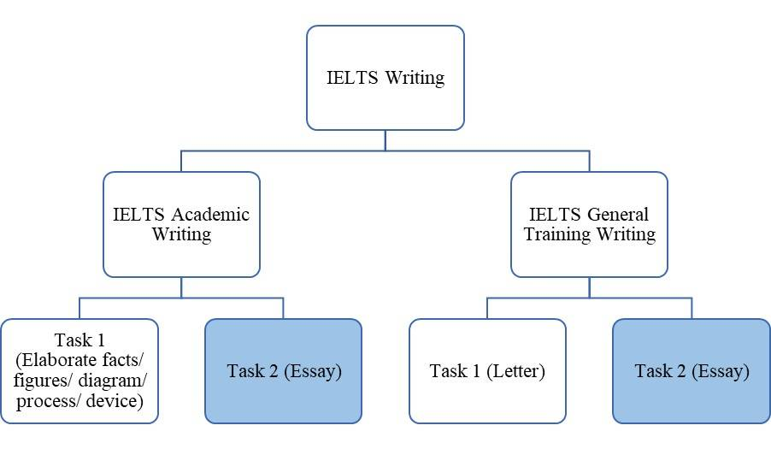

Slide 3
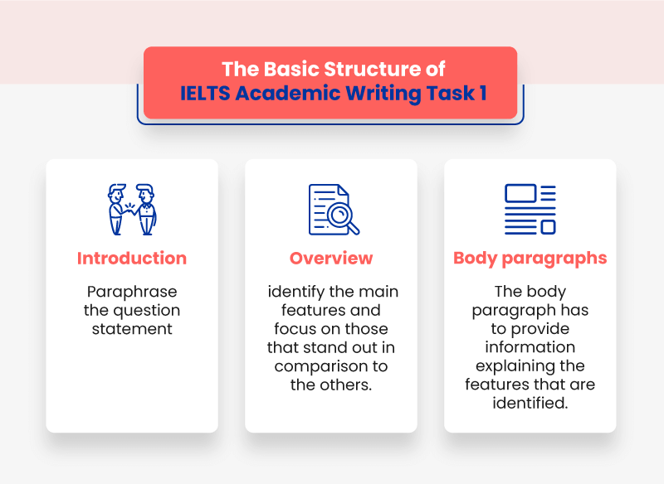

Slide 4
Academic Writing Task 1
Duration: 20 minutes Minimum Word Limit: 150 Words
Introduction (1-2 sentences) | Paraphrase the question.
Overview (2-3 sentences) | Study the entire data and try to understand the main point of the information. Don’t mention details.
Body (1-3 paragraphs/ 5-7 sentences) | Describe the data. Use paragraphs (if needed) to sort information by time, type or action.

Slide 5
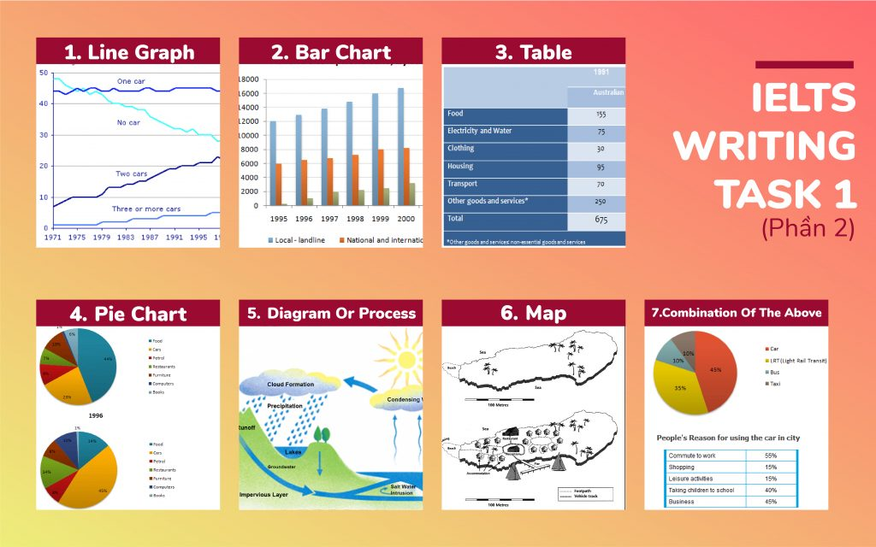
Types ….

Slide 6
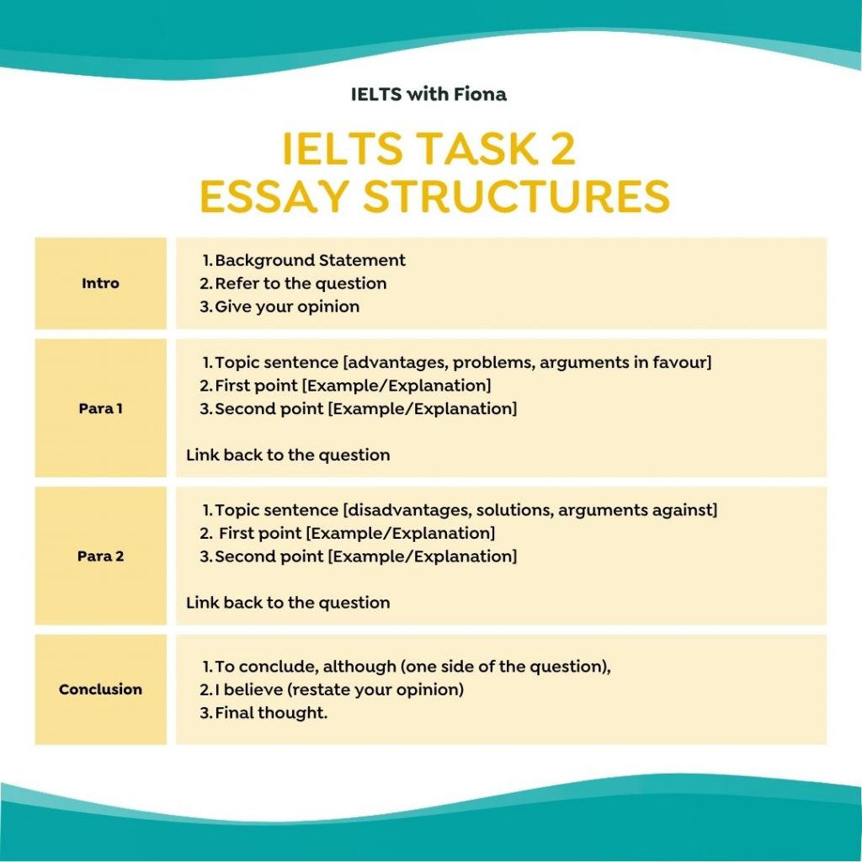
Duration: 40 minutes Minimum Word Limit: 250 Words
Writing Task 2 Structure

Slide 7
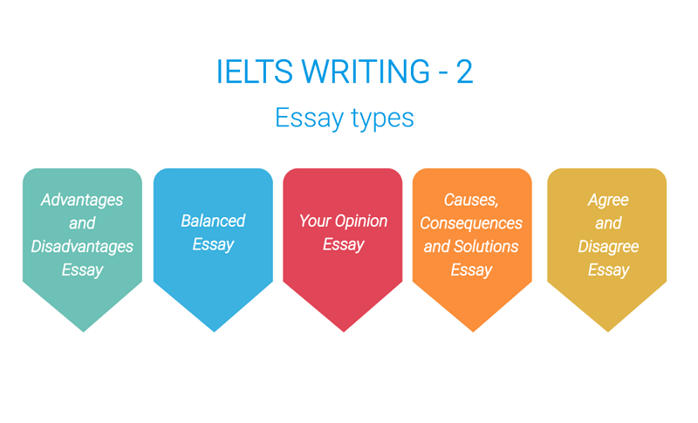

Slide 8
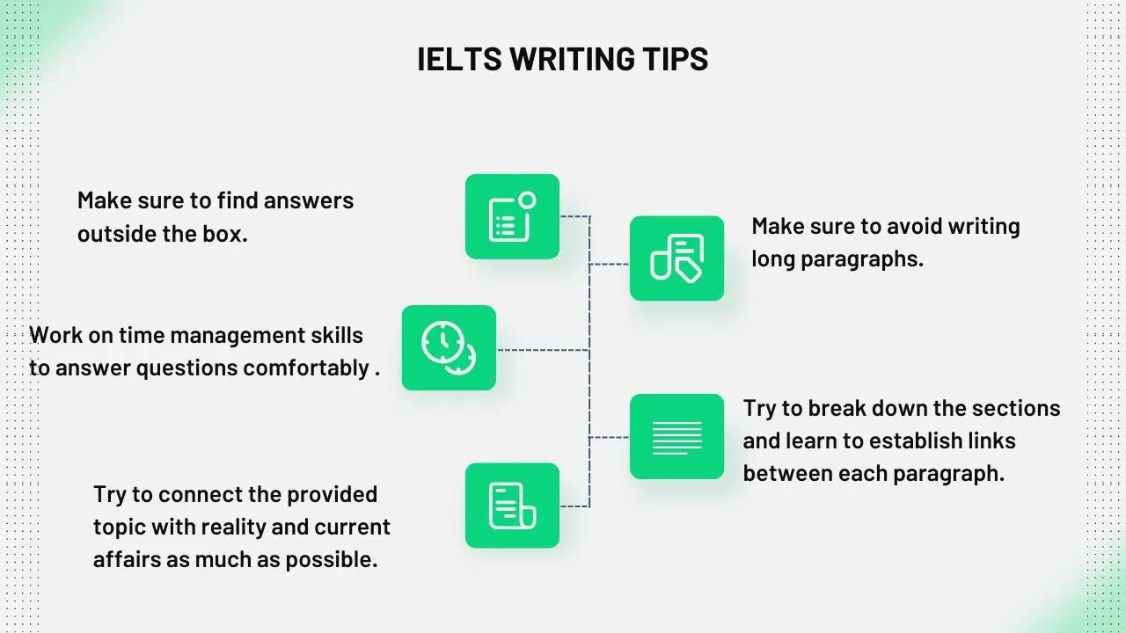

Slide 9
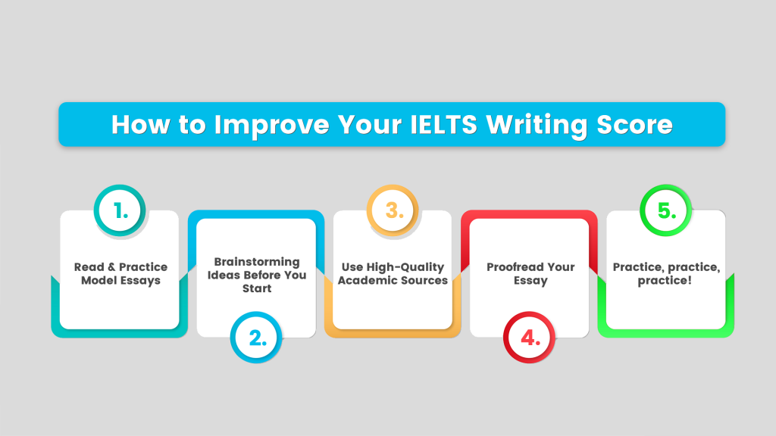

Slide 10


